Slide 1

Project: Hush Hush Recruiter
Big Data Programming: Python
By Team 12:
Sanath Vijay Haritsa
Aniket Ghetla
Spoorti Basarkod Math
Kshema Iliger
Vandit Bhalla

Slide 2
Problem Statement
Doodle is a famous software company that is in constant need of new developers, senior developers, and solution architects.
Hence, it wishes to automate the recruitment process to get the best potential candidates from the market, while also keeping it “Secretive”.
(Hush! Hush!)
2

Slide 3
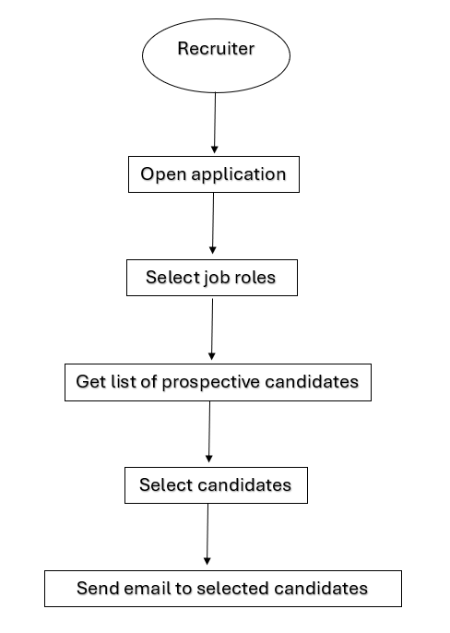
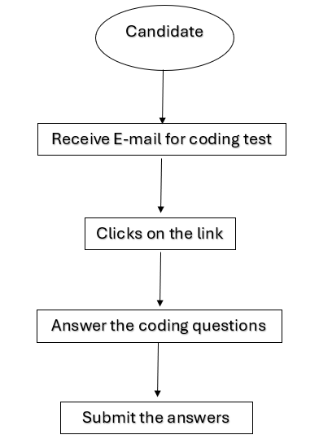
User Stories
3

Slide 4
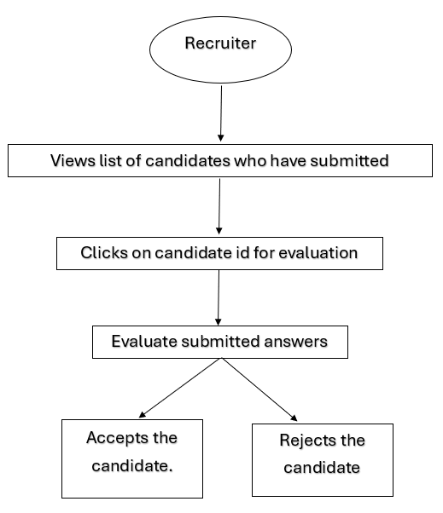
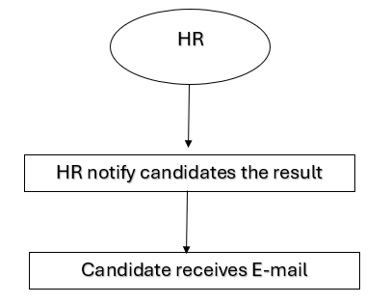
User Stories
4

Slide 5
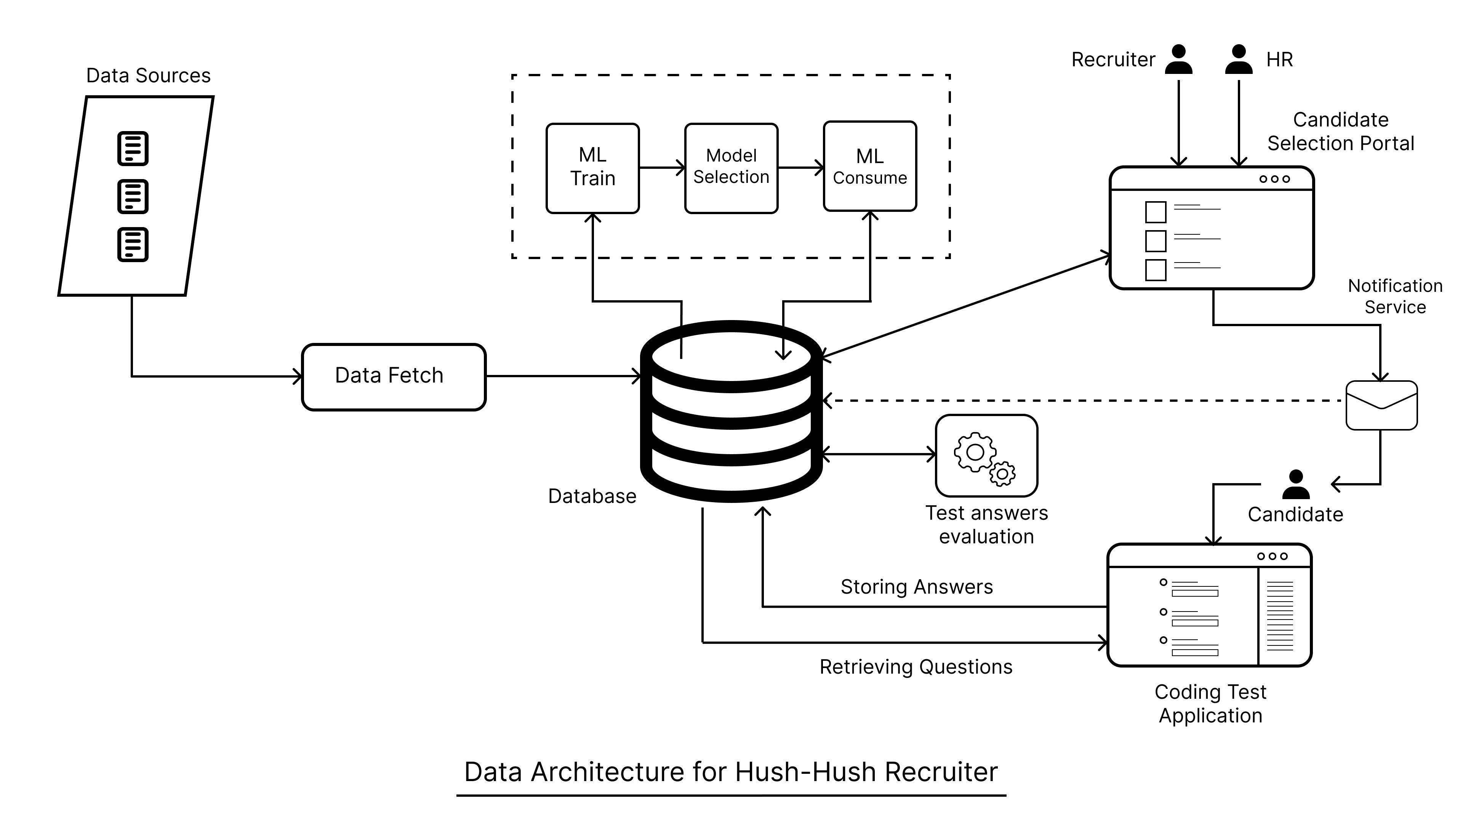
Data Architecture

Slide 6
Technologies Used
Backend – Python, Flask
Frontend – Html, CSS, Flask
Database – PostgreSQL
6

Slide 7
Data Sources
Source | API | Parameters |  | Rate Limit | Description
 |  | Path | Query
GitHub | https://api.github.com/users/{} | id |  | 5,000/hr | Get a user
 | https://api.github.com/search/repositories |  | template fork created Per_page | 5,000/hr | Search repo
StackExchange | https://api.stackexchange.com/2.3/users/{} | ids | page pagesize order sort site | 10,000/hr | Get users
7

Slide 8
Data Points
Data Points Fetched
GitHub | StackExchange
owner | display_name
size | reputation
stargazers_count | tb_gold
watchers_count | tb_silver
Language | tb_bronze
has_issues | tb_badge_names
has_projects
has_downloads
has_wiki
has_pages
has_discussions
forks_count
open_issues_count
topics
score
email
followers
following
Data Points used for clustering
GitHub | StackExchange
size | reputation
stargazers_count | tb_gold
forks_count | tb_silver
open_issues_count | tb_bronze
followers
following
Data points used for Classification
GitHub | StackExchange
size | reputation
8

Slide 9
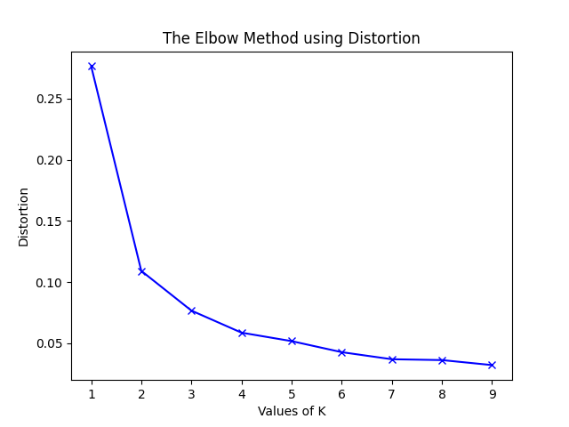
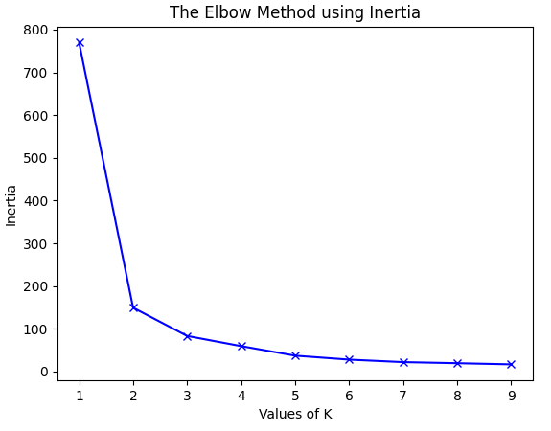
ML Algorithms
K-Means Clustering
9

Slide 10
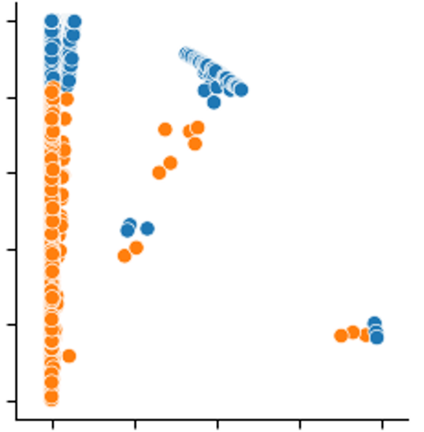
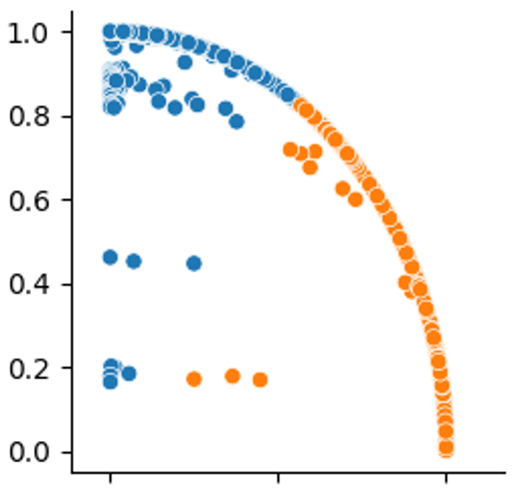
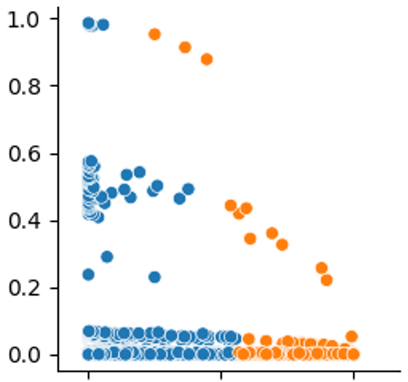
Feature Pair-Plot
reputation
reputation
size
followers
followers
size

Slide 11
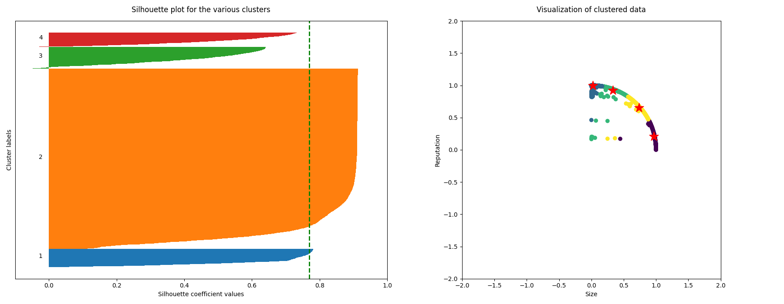
Silhouette Score
4 Clusters
11

Slide 12
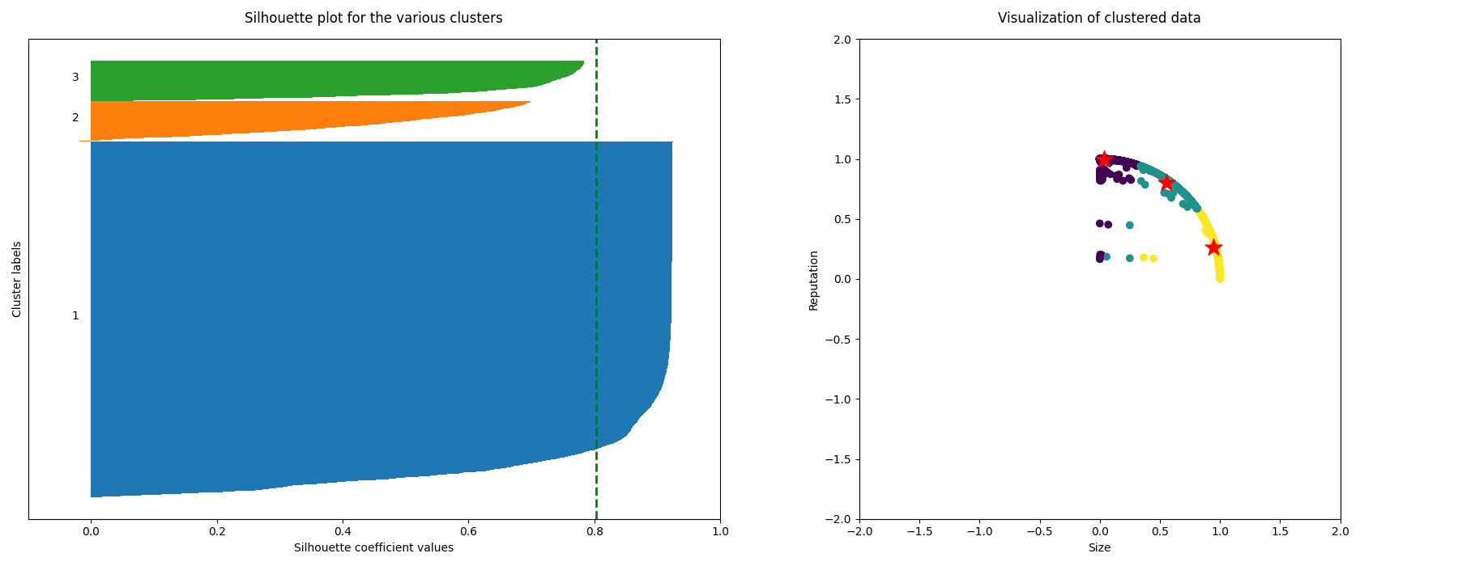
Silhouette Score
3 Clusters
12

Slide 13
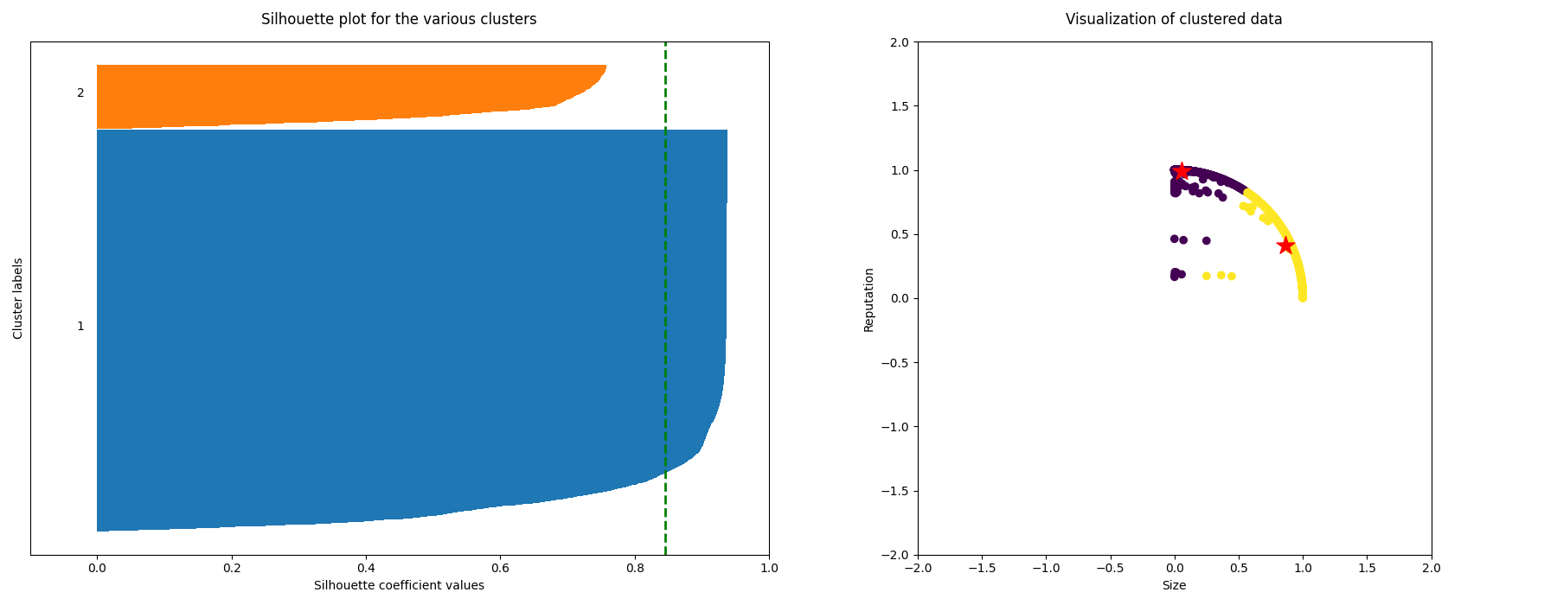
Silhouette Score
2 Clusters
13

Slide 14
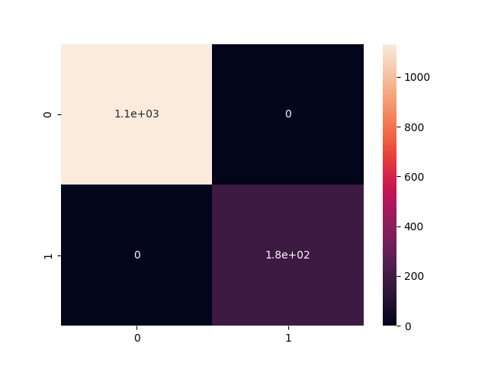
Confusion Matrix
14

Slide 15

Web Application
15

Slide 16
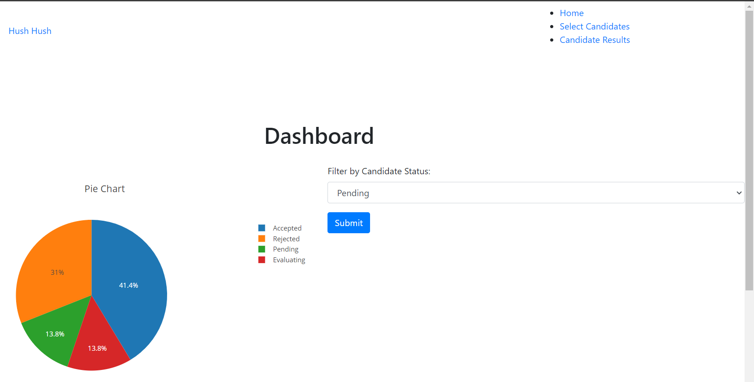
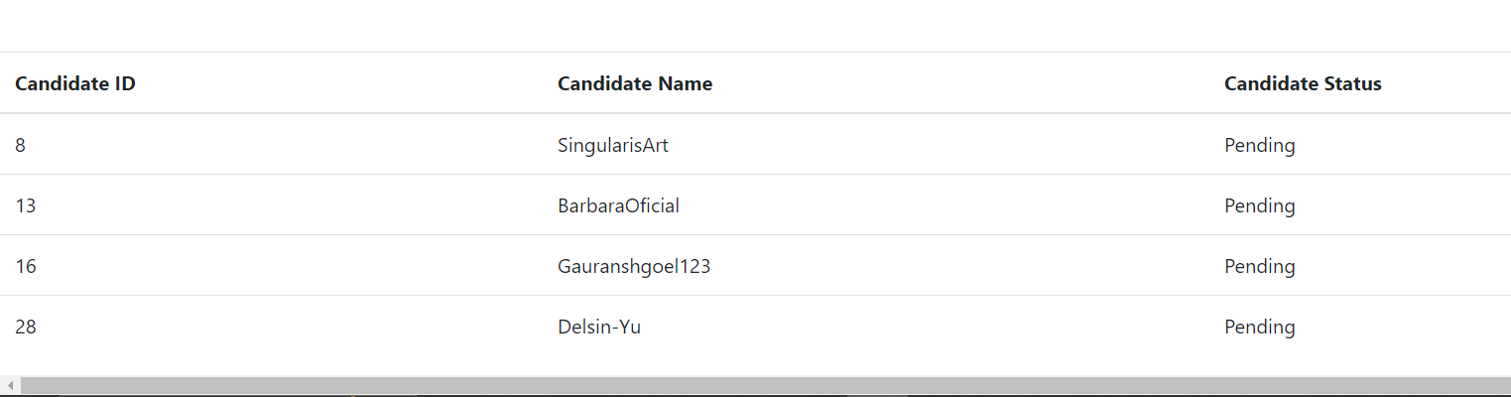
Web Application – Recruiter Home
16

Slide 17
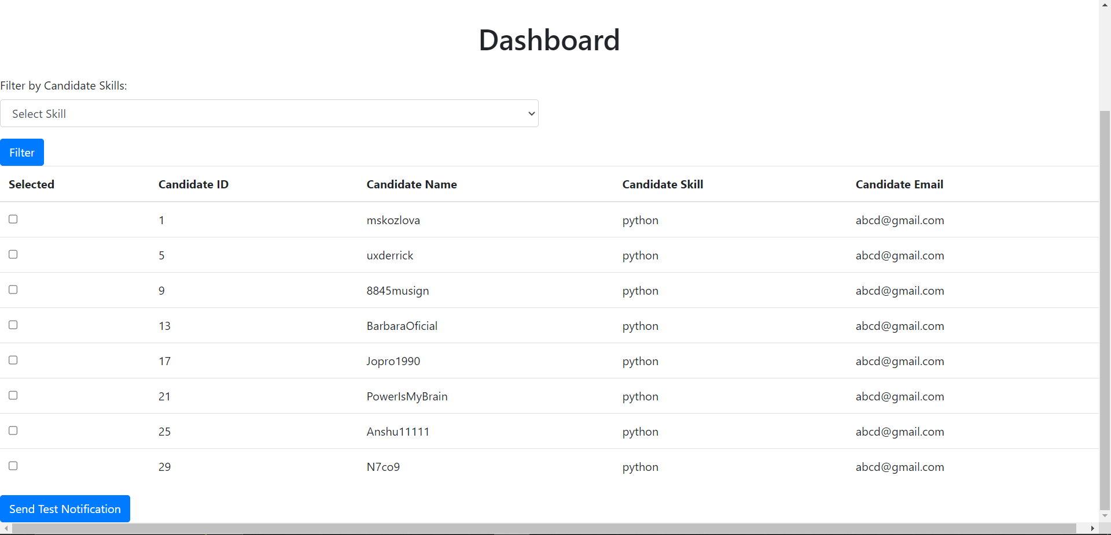
Web Application – Select Candidates
17

Slide 18
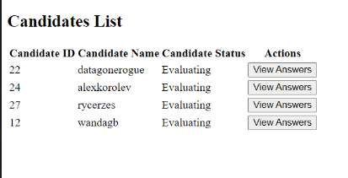
Web Application – Candidate Evaluation List
18

Slide 19
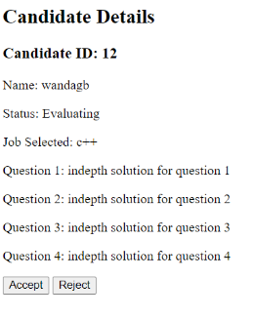
Web Application – Candidate Answers
19

Slide 20
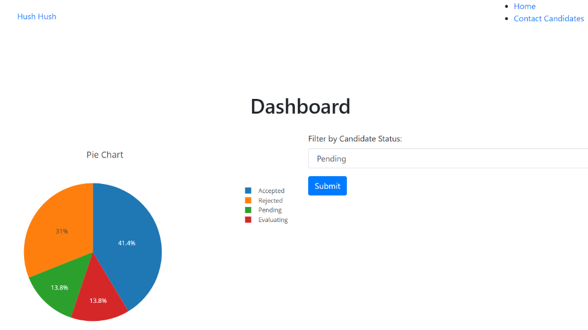
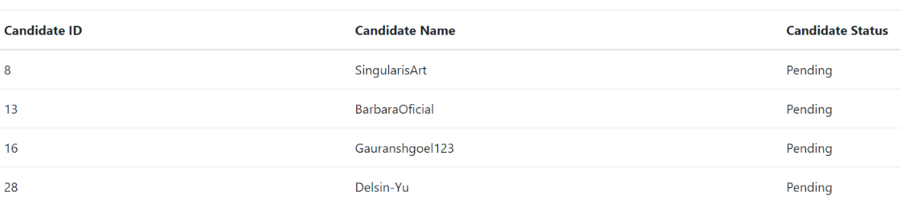
Web Application – HR Home
20

Slide 21
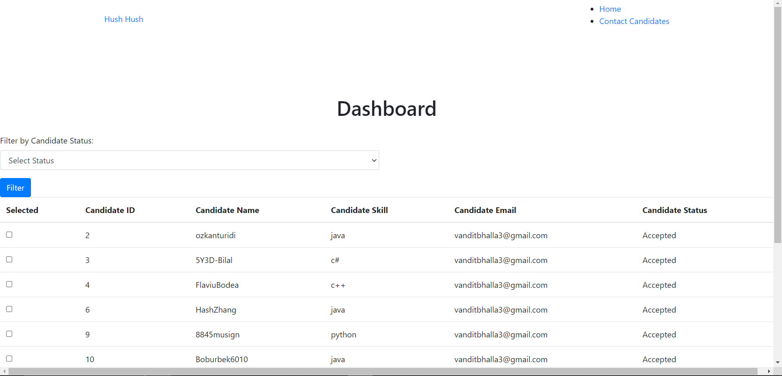
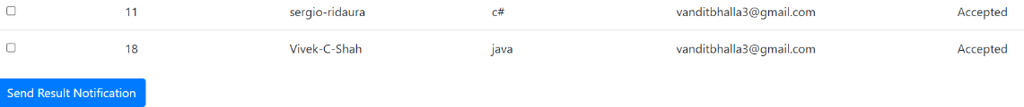
Web Application – Contact Candidates
21

Slide 22
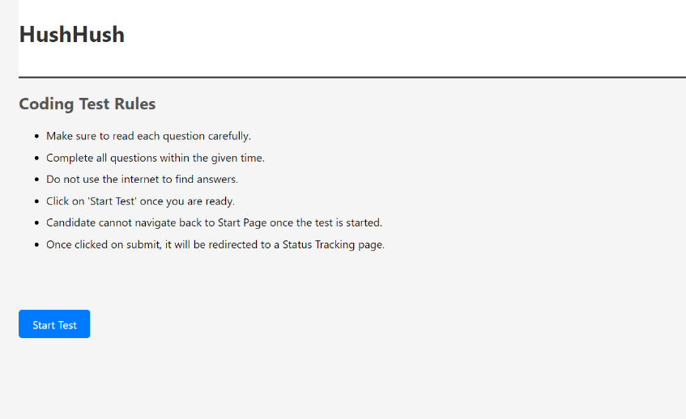
Web Application – Coding Test
22

Slide 23
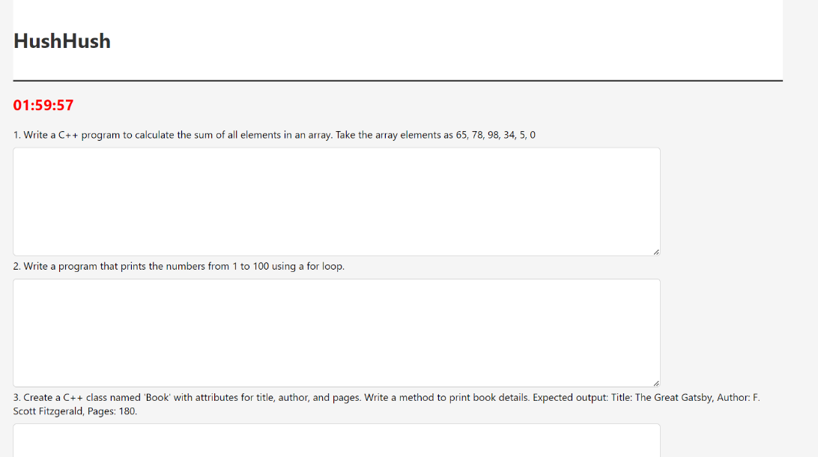
Web Application – Coding Questions
23

Slide 24
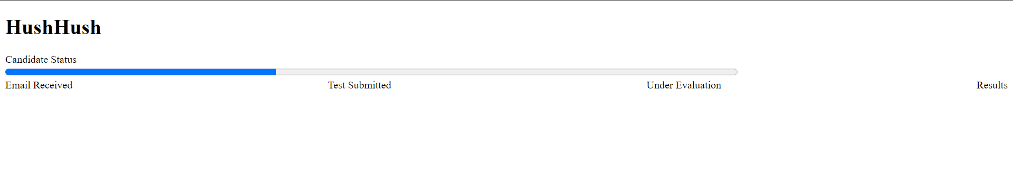
Web Application – Status Bar
24

Slide 25
Future Scope
Adding more data sources.
Automating candidate evaluation.
Have authentication and authorization of the applications.
Database normalization.
Improve UI/UX
25

Slide 26
References
https://api.stackexchange.com/docs
https://docs.github.com/de/rest?apiVersion=2022-11-28
https://flask.palletsprojects.com/en/3.0.x/
https://www.psycopg.org/psycopg3/docs/
https://scikit-learn.org/0.21/documentation.html
https://jinja.palletsprojects.com/en/3.1.x/
25

Slide 27
Thanks
26

